Slide 1
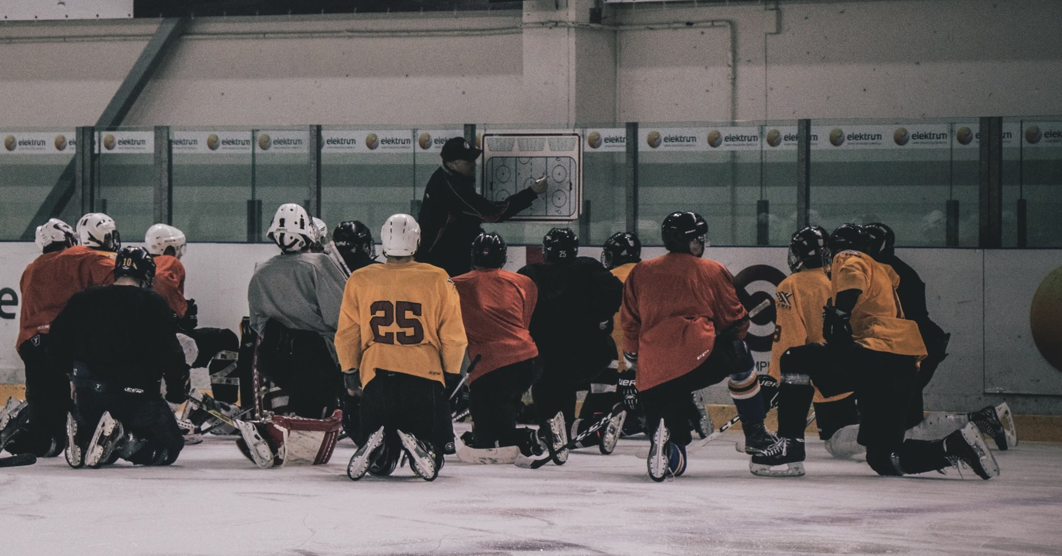
CKM SPORTS MANAGEMENT
THE INNOVATIVE WAY OF SPORTS SCOUTING
Presented by: Alexander Sukhanov, Emily Hagelauer , Thomas Atchison, Jonathan Steinberg, Justin Ma
Notes:
Identify the organization you are working with as well as the project given to you by the organization.
• Give a brief overview of the business and analytics problems/objectives.
• Provide a brief description of the data (how many datasets, types of files, etc.) + methodology + put them in per 60
• Present the results of your work in the tool used for the analysis (Tableau).
• Zoom in on some of the more sophisticated features of Tableau you have used.
• Discuss the business insight gained from the analysis; how did your work help the organization?
- which people are the best
- Future opportunity (to sell dashboard

Slide 2
AGENDA
SHEDDING LIGHT ON THE WORLD OF HOCKEY
01
COMPANY OVERVIEW
02
PROBLEMS & OBJECTIVES
03
DESCRIPTION OF DATA & METHODOLOGY
04
FINAL DELIVERABLE (TABLEAU)
05
DERIVED BUSINESS INSIGHTS

Slide 3
01
COMPANY OVERVIEW

Slide 4
CKM IS A LEADING FULL-SERVICE HOCKEY AGENCY
Company Overview
Development Services
Data-Driven Approach
Supports amateur and professional hockey players
Clients in 7+ professional hockey leagues (WHL, OHL, QMJHL, etc.)
Partners: Project Sport Agency, KeySport Agency, and Sport Agon
Athlete development (analytics, nutrition, strength & psychological training)
Post secondary education (SAT Preparation, Scholarship Attainment)
Financial planning (Taxes, Budgeting)
Branding & Sponsorships (Video production)
Determine a players’ strength, weaknesses, tendencies
Exploited for both development & negotiation utilization (agents, scouts, professional hockey programs)

Slide 5
02
PROBLEMS & OBJECTIVES

Slide 6

THE TOOL WILL EASE SCOUTING & BENCHMARKING
Problem: identifying top-tier hockey talent is a challenging task for scouts, which can result in missed opportunities for players and teams
Project: Interactive dashboards to assist scouts in identifying the best hockey talent at the minor league level
Purpose: Internal & external use of dashboards
Notes:
Analayticl problems/objectives. → top tier talent is hard to identify provind better ways to identify top talent -->

Slide 7
03
DATA OVERVIEW
& PRE-PROCESSING

Slide 8
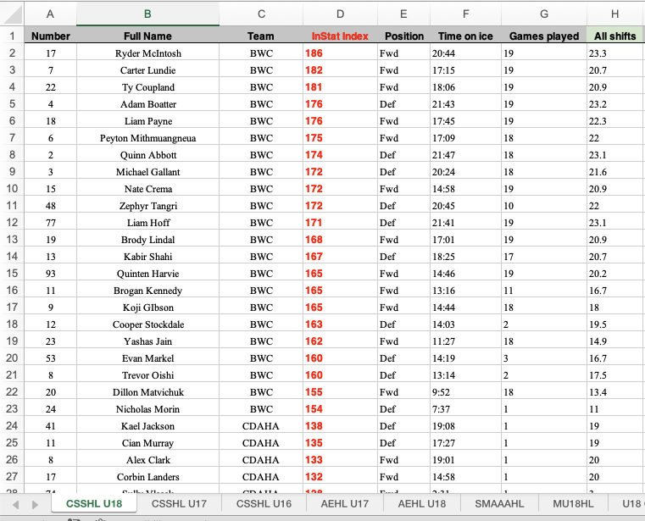

DATA OVERVIEW
DESCRIPTION OF DATA
Source
Breakdown
4,538 players
177 teams in 16 leagues
U16, U17, U18 ages
All within Canada
36 Features
General Information
Ice time
Points
Shots
Faceoffs

Slide 9
DATA PRE-PROCESSING
DATA PRE-PROCESSING
METHODOLOGY
Data Cleaning
Data Conversion
Feature Engineering
For each position:
Average form to total form
Converted statistics to per 60 form (normalized metric, facilities better comparison)
Extrapolated team totals
Created Relative team data (Stats as % of team totals, Assess team's most dominant players)
FINAL RESULT: Forward & Defense workbook with 4 worksheets each: Player Total Data, Per 60 Data, Team Total Data, Relative Team Data
Primary Points: Goals + First Assists
Offensive Impact: Percentile of Primary Points + Inner Slot Shots per 60
Defensive Impact: Percentile of Hits + Blocked Shots + Penalties Drawn Per 60
Outer Slot Shots: Total shots – Inner Slot Shots
Duplicate players
Time on ice formatting issue
Split Forwards and Defense

Slide 10
04
FINAL DELIVERABLE (TABLEAU)

Slide 11
05
DERIVED BUSINESS INSIGHTS

Slide 12
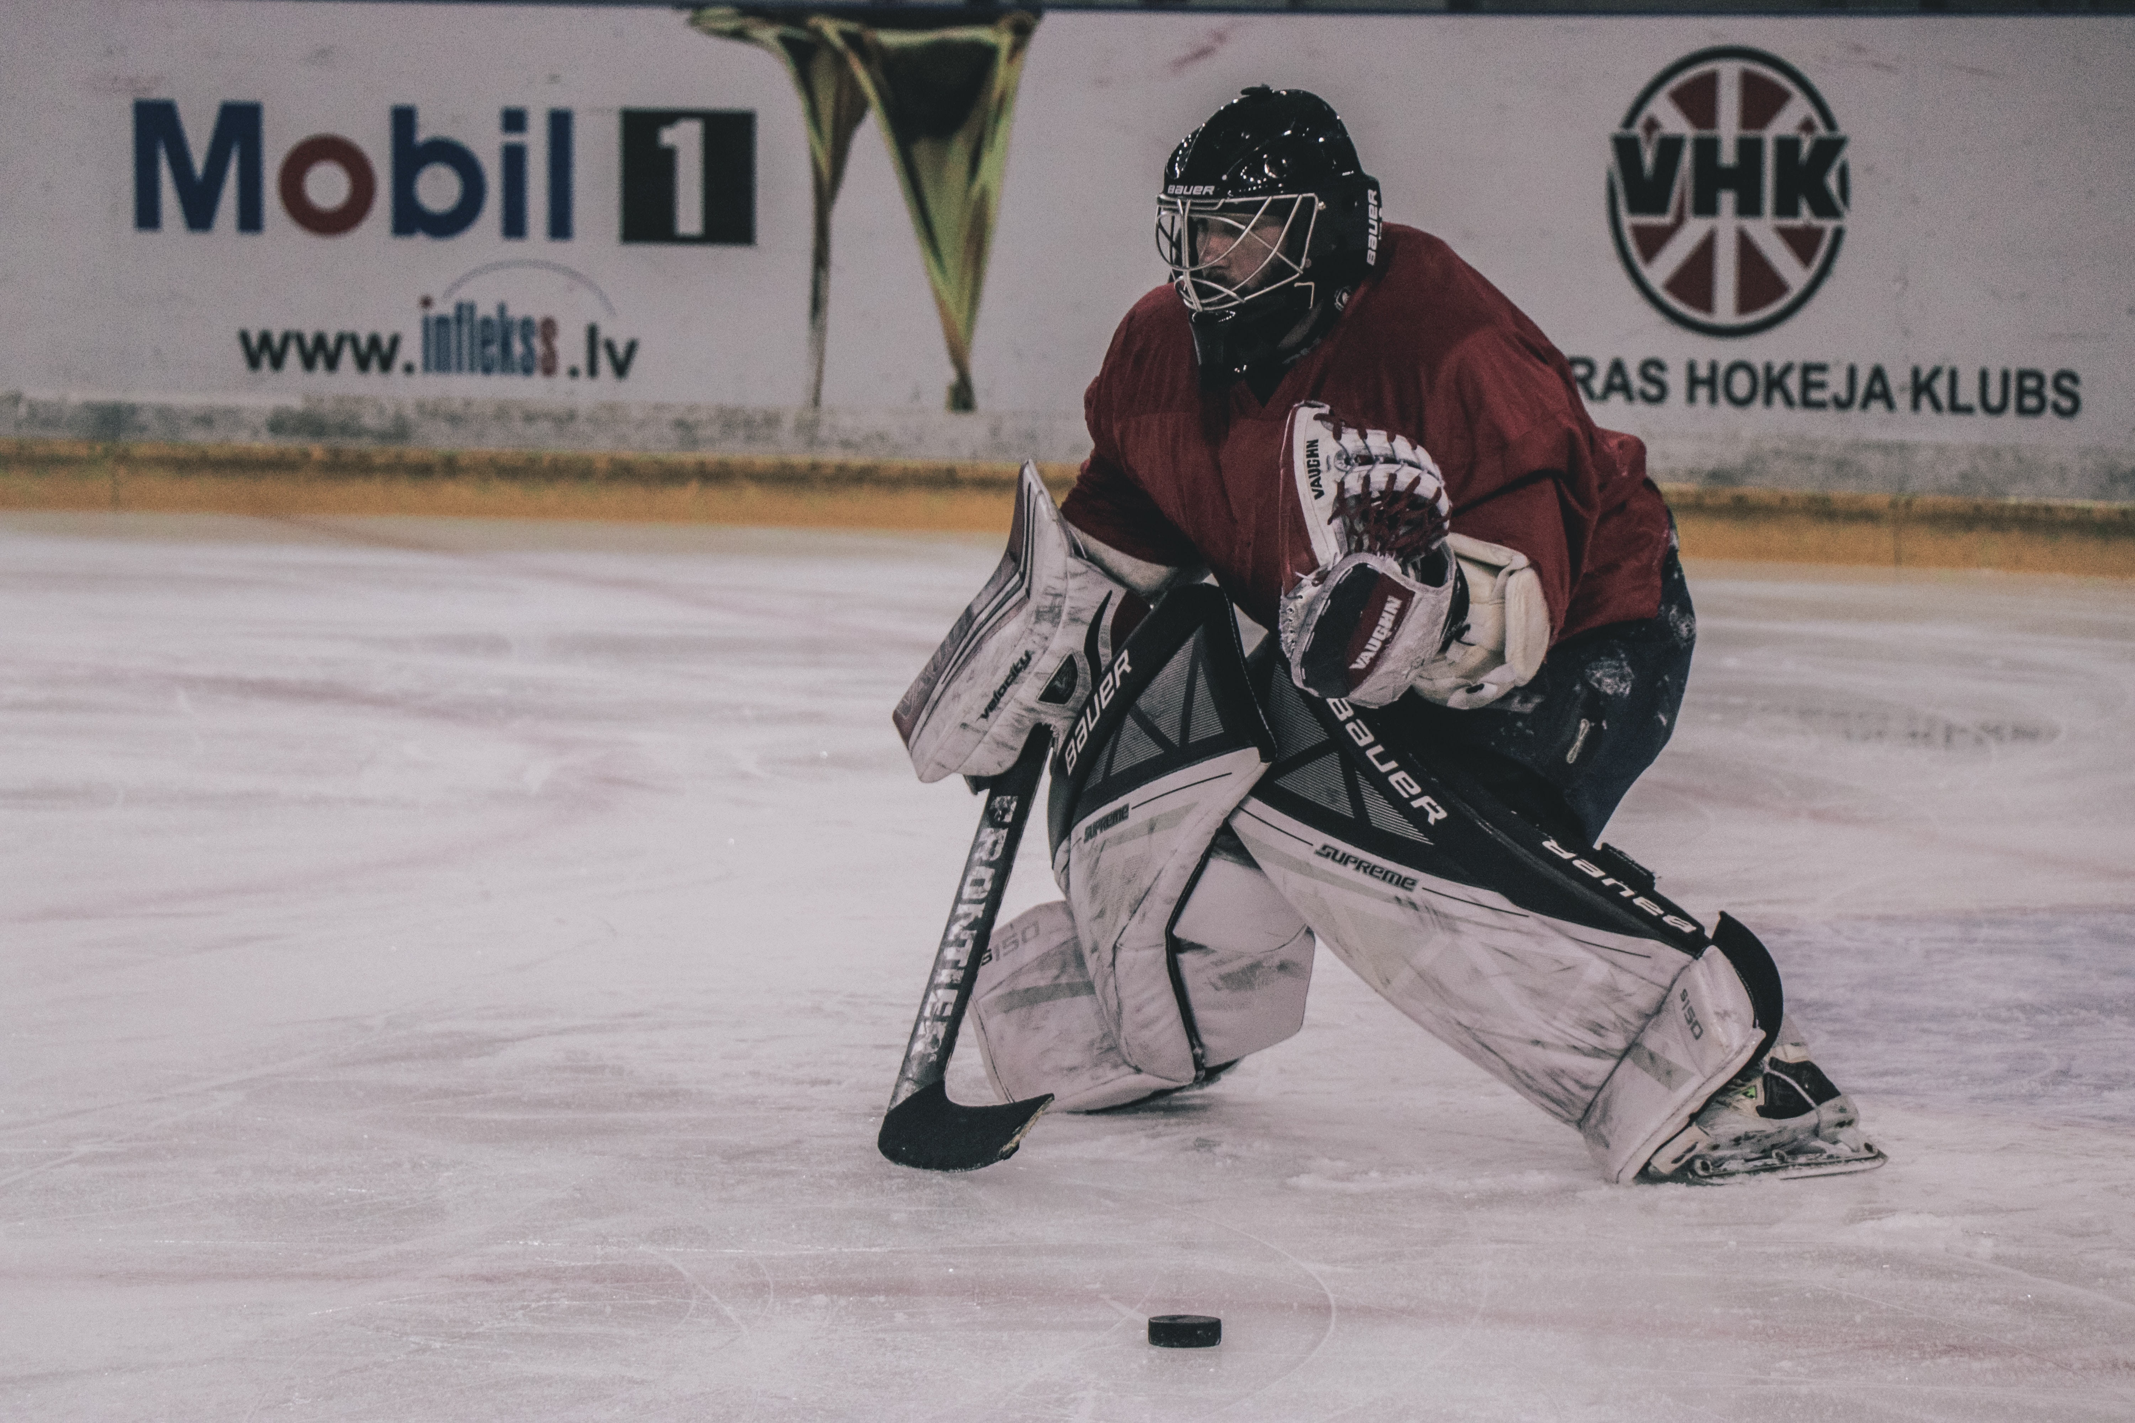



KEY BUSINESS INSIGHTS
HOW ARE TOOL CAN HELP
IN THEORY
TELLS A STORY
KEY METRICS
Interconnectivity across dashboard;
identification of players and causal factors
Focus on important metrics to go away from data overload.
And comparability
BUSINESS USER CONTROL
POSITION SPECIFIC
But the dashboard provides the overall direction.
Different metrics to evaluate forwards and defenseman.

Slide 13
THANK YOU!
QUESTIONS?

